Slide 1


Slide 2
Set Theory

Slide 3
Introduction
Definition – A Set is commonly defined as an assembly of items
Definition:
A Set is commonly defined as an assembly of items, recognized as foundations. These items could be anything possible, including digits, alphabets, colors, etc. However, none of the items of the set can be a set in itself.
Presentation of sets:
For example: P= {5, 6, 7, 8, 9, 10…….18} is the set of counting numbers beginning from 5. Q= {Black, white, Red, Yellow…} is a set of colors. R= {-3, -2, -1, ., 1, 2, 3….} is a set of all integers.

Slide 4
Sets Theory Formula or Rule
The set that consists of all the elements of a specified group is called the universal set and is denoted by the symbol ‘µ,’ also known as ‘mu.’
For two sets P and Q,
n(PᴜQ) is the number of items existent in either of the sets P or Q.
n(P∩Q) is the number of items existent in both the sets P and Q.
n(PᴜQ) = n(P) + (n(Q) – n(P∩Q)
For three sets P, Q and R,
n(PᴜQᴜR) = n(P) + n(B) + n(R) – n(P∩Q) – n(Q∩R) – n(R∩P) + n(P∩Q∩R)

Slide 5
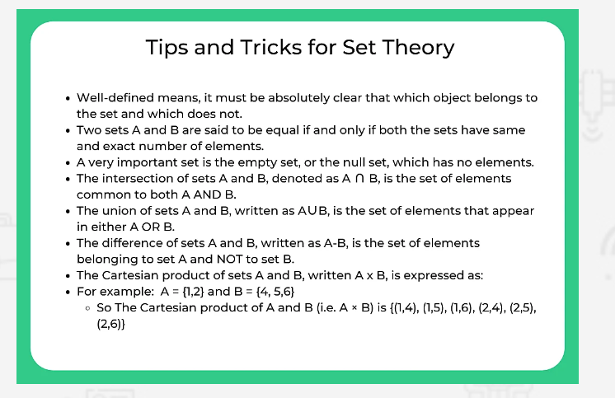

Slide 6
Formulas for Set Theory
Notations used in set theory:
n(A) – Cardinal number of set A.
n∘(A) – Cardinality of set A.
katex is not defined = A^{c} – complement of set A.
U – Universal
A ⊂ B – Set A is proper subset of subset of B.
A ⊆ B – Set A is subset of set B.
∅ – Null set.
a ∈ A – element “a” belongs to set A.
A ∪ B – union of set A and set B.
A ∩ B – intersection of set A and set B.

Slide 7
Formulas
If A and B are overlapping set, n(A ∪ B) = n(A) + n(B) – n(A ∩ B).
If A and B are disjoint set, n(A ∪ B) = n(A) + n(B).
n(A) = n(A ∪ B) + n(A ∩ B) – n(B).
n(A ∩ B) = n(A) + n(B) – n(A ∪ B).
n(B) = n(A ∪ B) + n(A ∩ B) – n(A).
n(U) = n(A) + n(B) – n(A ∩ B) + n((A ∪ B)c).
n((A ∪ B)c) = n(U) + n(A ∩ B) – n(A) – n(B).
n(A ∪ B) = n(A – B) + n(B – A) + n(A ∩ B).
n(A – B) = n(A ∪ B) – n(B).
n(A – B) = n(A) – n(A ∩ B).
n(Ac) = n(U)- n(A)

Slide 8
Question 1 :
In an examination hall with 60 students, their identity cards were examined. Some of them were not having Id card, some of them did not had admit card and some people were not having both of them. The If 20 people were having Id card and about 10 people had both, how many people did not had id and how many people did not had admit card?

Slide 9
Answer:
People having only Id card=n(A)={20-10}= 10 People having only admit card= n(B) = {20-10}=10 Let n(S) be: People having None =n(A)-n(B) = {60-20}= 40 Ans.

Slide 10
Question 3 :
If set A ={1,2,3,4} set B={3,6,7,8} and set C={6,7,8,9} then write the universal set for all the three sets?

Slide 11
Answer:
If U is universal then U must contain Elements of setA+setB+setC U={1,2,3,4,6,7,8,9}

Slide 12
Question 4 If A= { X,Y,A,B} B= {T,U,V,X} C= {T,M,N,B} then find (A ∩ B) ∩ ( B ∪ C).

Slide 13
Answer:
(A ∩ B) = {X} ( B ∪ C)= {T,U,V,X,M,N,B} (A ∩ B) ∩ ( B ∪ C)= {X} .

Slide 14
EXERCISE 2:
A class had a strength of 40 students numbered from 1 to 40. Students with even roll numbers were doing English literature, while students with roll numbers in multiples of 4 were doing Fashion Design, and students with roll numbers in multiples of 8 were in the technical field.
Calculate the number of students who opted for none of the three streams?
a)30
b) 20
c) 45
d) 50

Slide 15
Question 5:
Given set A={9,0} B={9,0,18,27,36} Is A⊂ B? Find A∩B

Slide 16
ANSWER:
Yes A⊂B as elements of A are present In B. A∩B= {9,0}

Slide 17
QUESTION 6
In a classroom 10 students has Computer as optional subject and 30 student has Physical education as their optional subject and rest all others have Sanskrit find the number of students who have sanskrit as optional subject if the total number of student in class are 60?

Slide 18
ANSWER:
Set A = Student with CS{10}
Set B = Student with PE {30}
Other students = n(A)+n(B)-n(U) = 10+30-60= 20

Slide 19
EXERCISE 1:
In a class of 100 students, 35 like science and 45 like math. 10 like both. How many students like neither of them?
a) 30
b) 24
c)31
d)18

Slide 20
ANSWER:
Total number of students, n(µ) = 100 Number of science students, n(S) = 35 Number of math students, n(M) = 45 Number of students who like both, n(M∩S) = 10 Number of students who like either of them, n(MᴜS) = n(M) + n(S) – n(M∩S) => 45+35-10 = 70
Number of students who like neither = n(µ) – n(MᴜS) = 100 – 70 = 30
CORRECT ANSWER(A)

Slide 21
EXERCISE 2:
1. "There are 20000 people living in Defence Colony, Gurgaon.
Out of them 9000 subscribe to Star TV Network and 12000
to Zee TV Network. If 4000 subscribe to both, how many do
not subscribe to any of the two?"
2. In a class of 212 students, each student studies at least one of the three subjects Mandarin, French and Spanish. 96 of them study Mandarin, 102 studies French and 106 Spanish. 32 studies Mandarin and French, 34 study Mandarin and Spanish and 36 study French and Spanish. How many students study all the three subjects?
Notes:
ANS:3000

Slide 22
EXERCISE 3:
In a group of 60 people, 27 like tea and 42 like coffee and each person likes at least one of the two drinks. How many like both coffee and tea?
a) 12
b) 3
c) 8
d) 9

Slide 23
ANSWER:
Let Tea= Set of people who like tea
Coffee = Set of people who like coffee
Given,
(T∪C) = 60
n(T) = 27
n(C) = 42
n(T) + n(C) – n(T ∪ C)
= 27 + 42 – 60
= 69 – 60 = 9
= 9
Therefore, 9 people like both tea and coffee.
CORRECT ANSWER (D)

Slide 24
EXERCISE 3 :
Let A and B be two finite sets such that n(A) = 24, n(B) = 37 and n(A ∪ B) = 46, find n(A ∩ B).
a)12
b) 15
c) 8
d) 4

Slide 25
ANSWER:
Using the formula n(A ∪ B) = n(A) + n(B) – n(A ∩ B).
then n(A ∩ B) = n(A) + n(B) – n(A ∪ B) = 24 +37 – 46
= 61- 46 = 15
CORRECT ANSWER (B)

Slide 26
EXERCISE 4:
A class consisted of 50 students, 20 were studious and liked to do physical activities also and 10 only liked to study how many students came under none of the above category?
a)12
b) 25
c) 30
d) 4

Slide 27
ANSWER:
Using the formula n(A ∪ B) = n(A) + n(B) – n(A ∩ B).
then n(A ∩ B) = n(A) + n(B) – n(A ∪ B) = 20+10 – 10-50
= 30
CORRECT ANSWER (C)

Slide 28
EXERCISE 5:
In a college 500 students speak Hindi 200 speak English and 200 speak both Hindi and English, find the number of students in the college?
a)300
b) 200
c) 450
d) 500

Slide 29
ANSWER:
Number of students who speak Hindi =n(H)=500
Number of students who speak English =n(E)=200
Number of students who speak both =n(HUE)=200
U=n(H)+n(E)-n(HUE)= 500+200-200=500
CORRRECT ANSWER(D)

Slide 30
ANSWER:
Students doing Eng. Literature= n(E)
Students doing Fashion Design= n(F)
and Students doing Technical Eng.= n(T). Now n(E) = 40/2= 20 n(F)= 40/4= 10
n(T) = 40/8 = 5 The 4th, 8th, 12th…… numbered students would be doing both English and Fashion design ∴ n(E∩F) = 40/4 =10 The 8, 16th, 24nd…… numbered students would be doing both English and Technical Eng ∴ n(E∩T) = 4 = 5 The 8th, 16th, …… numbered students would be doing both Fashion design and Technical Eng ∴ n(F∩T) = 40/8 =5 And a total of 5 students must be doing all 3 courses. ∴n(E∩F∩T) = 5 Now, n(E∪F∪T) = n(E)+n(F)+n(T) – n(E∩F) – n(E∩T) - n(F∩T) + n(E∩F∩T) = 20+10+5-5-5-10+5
=20 ∴ Number of students doing nothing = 40-20= 20
Notes:
ANS:31

Slide 31
Exercise 7:
A group of tourists were traveling together on a train. 12 Tourists were able to speak Spanish, 30 could speak only French, and 12 could speak German. And no one from that group could speak any other language. If 4 persons in the group were able to speak two languages and 2 people were able to speak all the three languages, then calculate the total number of tourists in that group?
a)10
b) 42
c) 45
d) 40
Notes:
ANS:22

Slide 32
ANSWER:
Let the 2 languages that these 4 people could speak easily be Spanish and French.
Mentioned that 2 people can speak all the three languages.
Tourists who could speak Spanish= 12.
Therefore tourists who could speak only Spanish= 12 – 4 – 2= 6
Tourists who could speak French= 30.
Therefore no. of tourists who could speak only French= 30 – 4 – 2= 24
Tourists who could speak German= 12.
Therefore no. of tourists who could speak only German= 12- 4 – 2= 6
Hence Tourist who could speak only 1 language= 6+24+6= 36
Tourists who could speak only 2 lang. = 4
Tourists who could speak all the lang = 2
Hence total number of tourists= 36+4+2= 42
Notes:
ANS:17

Slide 33
Exercise 8:
In a recent survey conducted in a school, it was discovered that 80 students preferred an I-phone, whereas 60 students went for an Android phone. However, 20 Students were not that particular and accordingly could go with any of them. If each student preferred to have at least one of the items, find out how many students the survey was conducted?
a)120
b) 62
c)100
d) 60
Notes:
ANS:correct

Slide 34
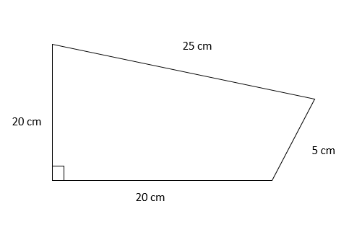
ANSWER:
It is evident from the diagram that the total number of students on whom the survey was conducted= 60+20+40= 120
Students who preferred I- Phone= n(P)
Students who preferred Android= n(A)
Therefore n(P∩A) Students who could prefer both. Thus using the formula n(PUA) = n(P) + n(A) – n(P∩A) n(PUQ) = 80 + 60 – 20= 120
Notes:
ANS:correct

Slide 35
THANK YOU

